Slide 1

Interview Scheduling
    Group Members
    Archana R
    Margi B
    Akanksha D
    Maneesha S
    Mentor
    Ramith Padaki

Slide 2


Problem Statement
Given a set of free room slots and free interviewer slots, schedule interviews in the available slots and intimate the interviewer
Send an email invite with the time slot alotted and the room number.

Slide 3

Assumptions
Each interview is for a one hour duration.
Interviewer slots are entered for a duration of one hour.

Slide 4
Approaches used
Greedy Algorithm
Maximum Bipartite matching

Slide 5

Greedy Algorithm
Combine all continuous slots of the rooms
Sort the room slots and interviewer slots in the increasing order of the end times.
Assign the suitable interviewer to the room and calculate the remaining free slot of the rooms.
Repeat the above step until all the interviewer slots and room slots are scanned.
Send email to the corresponding interviewer with details of time and room.
Time complexity is O(mn + mlogm+nlogn) [n = # of room slots, m = # of interviewer slots]

Slide 6
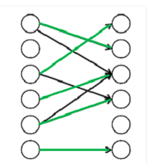
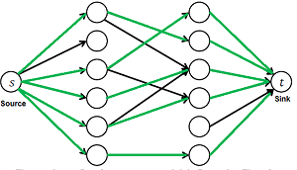
Maximum Bipartite matching
Interview Scheduling can be solved using Maximum Bipartite Matching (MBP) by converting it into a flow network
There must be a source and sink in a flow network.
We use Ford-Fulkerson algorithm to find the maximum flow in the flow network which gives the maximum number of interviews that can be scheduled.
The augmenting paths after the algorithm stops gives the assignment of rooms to the interviewers.
Time complexity O(n(mn+m+n))=O(mn²). [n = # of room slots, m = # of interviewer slots]

Slide 7
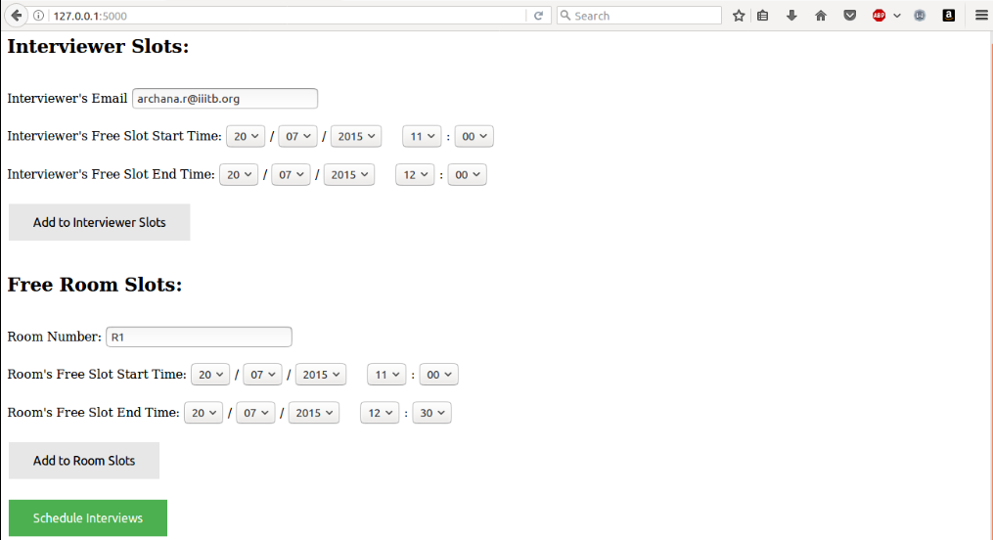
Screenshots
Input screen

Slide 8
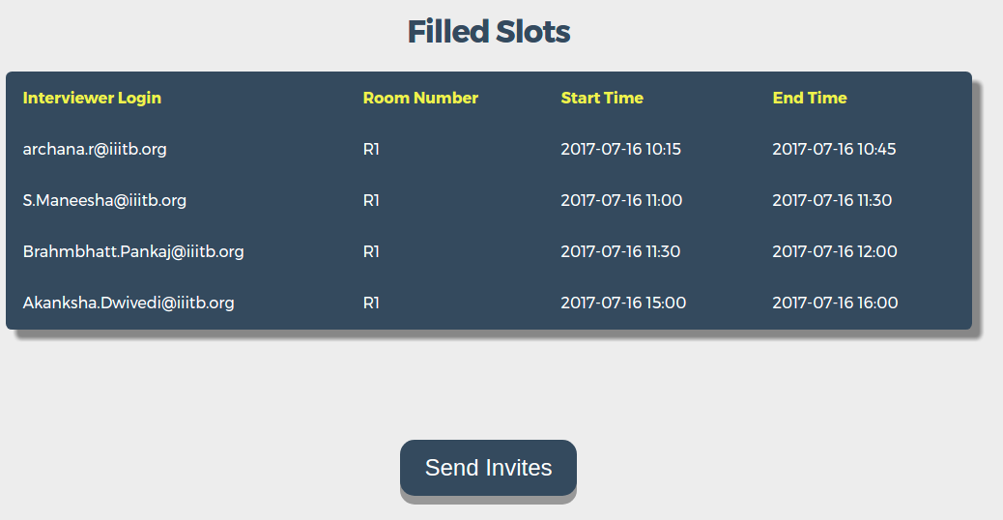
Screenshots
Scheduled Interviews

Slide 9
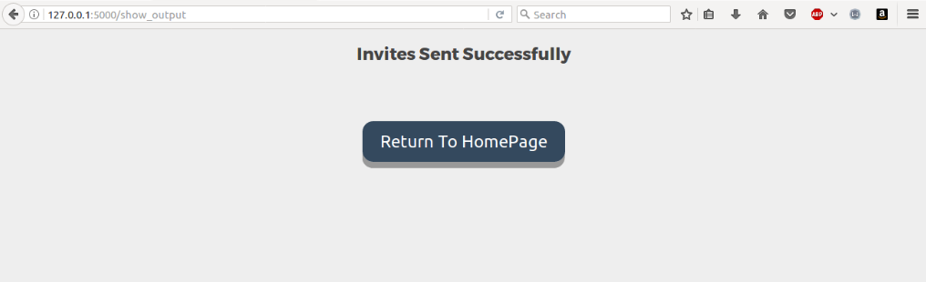
Screenshots
Final screen

Slide 10



Technologies
UI to accept inputs – HTML,CSS
Convert the inputs to JSON input file
Algorithm implemented in Python
Flask Server

Slide 11



Future Work
Enhance the algorithm to accept slots of Interviewees also.
Schedule panel interviews
Schedule group interviews

Slide 12

Queries ??????

